Slide 1
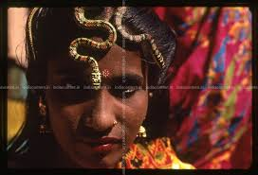
Welcome today’s class

Slide 2
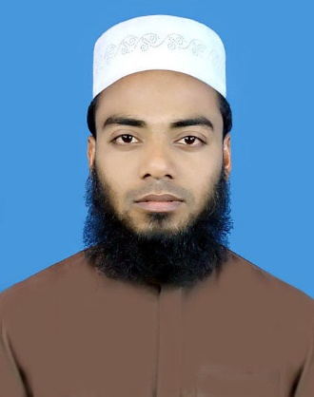
Introduction
Class: Eight
Unit: Seven
Lesson: Four
Time : 50 minutes
Md. Zahidul Islam Zahid
Asst.Teacher
Qaumi Jute Mills High School,Sirajganj.
Email: zahidulteacher@gmail.com

Slide 3
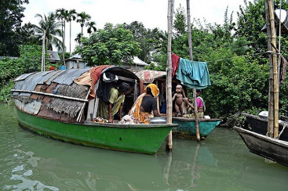
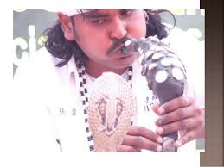
1.What do you see in the pictures ?
2.Where do they live in Bangladesh?

Slide 4
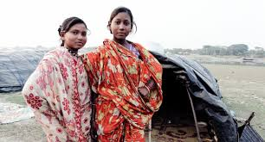
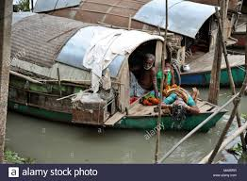
River gypsies in Bangladesh.

Slide 5
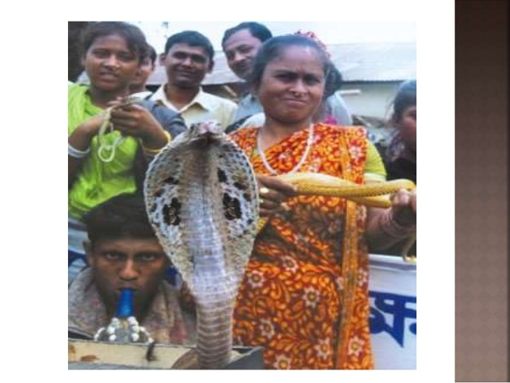
So today’s lesson is river gypsies in Bangladesh.

Slide 6
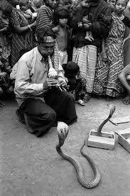
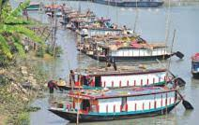
Bedeys catch snakes during the winter/rainy/summer season.

Slide 7
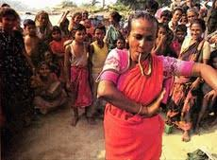
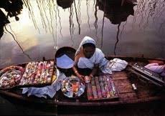
Females of the bedey families contribute to the family income.

Slide 8
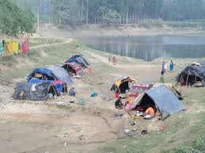
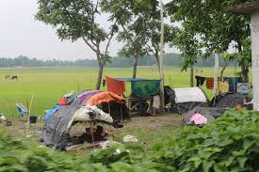
River gypsies are used to water life but they
Come to plain land in dry season.

Slide 9
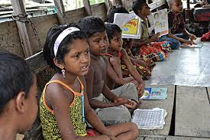
Mobile boat-schools for the gypsy children.

Slide 10
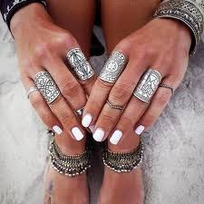
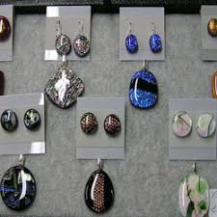
The lifestyle of river gypsy.

Slide 11
Individual work
1.What are the main problems that river gypsies are faching?
2.What is the effect of global climate change in Bangladesh?
3.Why can’t river gypsy children go to conventional school?

Slide 12
Imagine there is a boat-school in your area to teach river gypsy children. Write a short composition about how you can help the gypsy children with learning.

Slide 13
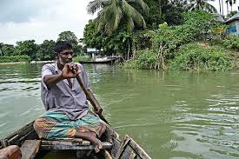
Thank you all

